Slide 1

Year 2
Year 2
Home Learning
18th – 22nd May 2020
Always do your best and
be your best

Slide 2

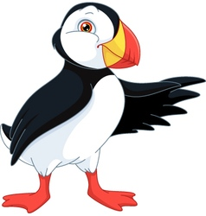

Hello Everyone
As with previous weeks, we’ve put together some resources to help you support your child. We hope you find this information helpful.
Can we stress again that the activities are not intended to cause additional anxiety. They are there if you would like some structure whilst we are experiencing these unusual times. If you have any concerns about how your child is coping or you need any other support from the school, please let us know.
As ever, the most important thing to our School Family is the wellbeing of our children and their families.
Thank you
from The Year 2 Team

Slide 3
Home Learning Support
The next activities will keep you thinking and stretching your brain at home. Most are activities that you don’t need to print out. If you have pencil and paper, you should be able to complete most of these tasks. You may have lots of your own ideas that you would also like to try.
There are activities for 5 days, and you can work through the tasks at your own pace. Parents/Carers, you can support as and where necessary to help your child get the best from the activities.
We would love to hear how your child is getting on. If they have done anything exciting or that they are particularly proud of, please email it to school or put it on our school’s new Facebook Page.
We are missing you all, and sending you all our very best wishes,
From the Year 2 team

Slide 4


Reading
Daily Reading
Don’t forget, reading is very important. You should aim to read a little each day.
You can find lots of books to read for free here:
https://www.oxfordowl.co.uk/for-home/find-a-book/library-page/
https://connect.collins.co.uk/school/teacherlogin.aspx
Username: Parents@harpercollins.co.uk
Password: Parents20!
There are lots of books to choose from, including colour banded books.
Can you find any books that link to our ‘Plants’ topic?
You can also sign up for free trials for more books here:
‘Rising Stars’ Free trial: https://www.risingstars-uk.com/series/reading-planet/products/rising-stars-reading-planet-online-library
‘Raz Kids’ free trial: https://www.raz-kids.com/
‘Epic!’ free trial: https://www.getepic.com/
Ruth Miskin RWI basics: https://www.ruthmiskin.com/en/find-out-more/parents/

Slide 5
English Lesson 1
Practise this week’s spellings and put them into sentences
These are from the ‘Next 200 Common Words’ list that KS1 children are expected to spell correctly.
Some are easier than others and can be ‘sounded out’.
We will tackle them in alphabetical order.
across
after
again
air
along
animals
another
any
around
away
You could play Look-Say-Cover-Write-Check.
Write the spellings out 3 times and then write 10 sentences using each spelling once. Don’t forget capital letters, spaces and full stops.
Extra Challenge: Try to include adjectives (describing words) or Verbs (action words)
There are some fun Spelling Games here:
https://www.topmarks.co.uk/english-games/5-7-years/words-and-spelling

Slide 6
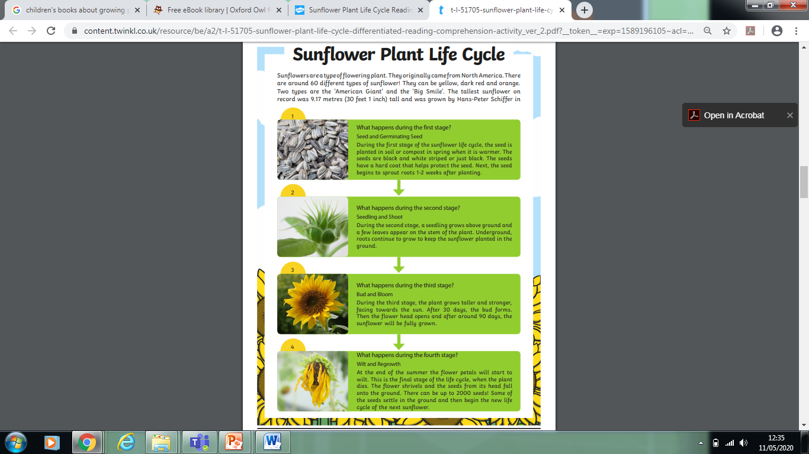
English Lesson 2
Comprehension
Task: Read the text and answer the questions.
Extra Challenge:
Write the answers in full sentences
Where did Sunflower plants originally come from?
2. How many different types of sunflowers are there?
3. How tall was the tallest sunflower ever grown?
4. Why is the seed planted in Spring?
5. What colour are the seeds?
6. How long will it take for the seed to begin to sprout?
7. Which part of the plant do the leaves grow from?
8. What do the roots do underground?
Challenge steps: 1. Someone can help you with sounding out the words.
2. You try to sound out yourself.
3. You read independently.

Slide 7
Lesson 2 cont’
9. When does the bud form?
10. What happens when the flower shrivels?
How many new seeds can fall from the head of the shrivelled flower?
12. What can happen to those seeds when they fall to the ground?

Slide 8
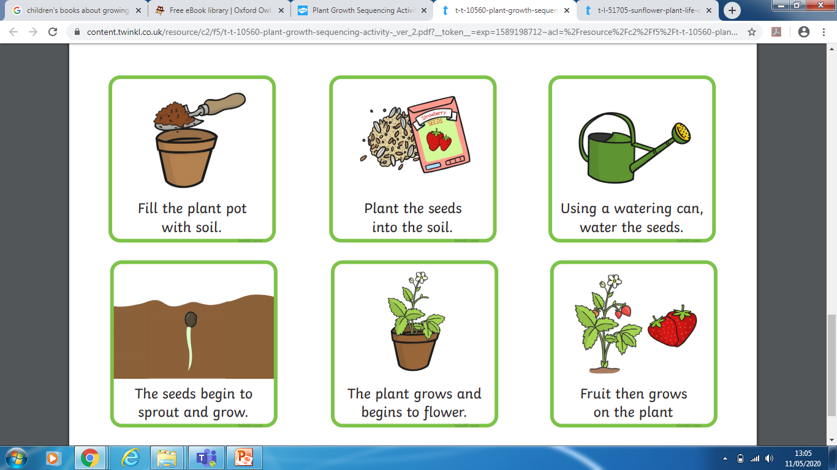
Lesson 3
Sequencing Instructions
These instructions are in the wrong order.
Task 1: Can you work out the correct sequence?
Extra Challenge: Use diagrams and write sentences to create your own instructions.
Write them in the correct order.
Useful words: First, Then, Next, After that, Later, Lastly, Finally

Slide 9
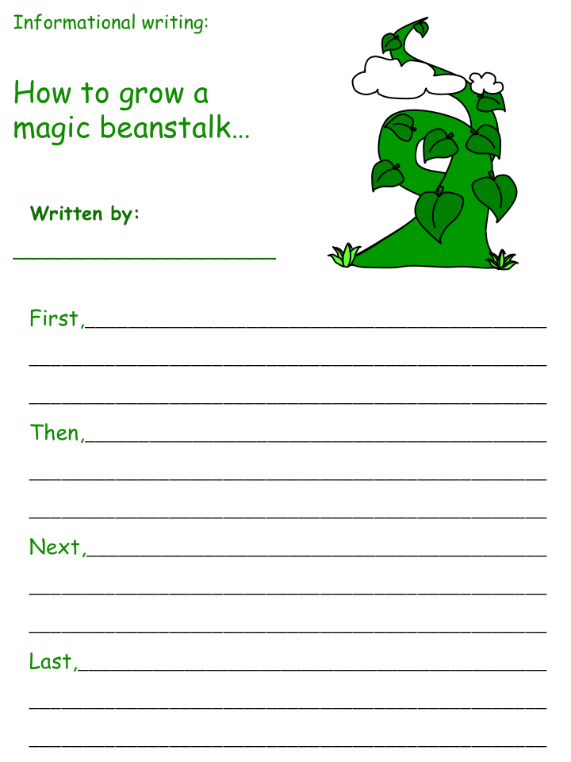
English Lesson 4
Write some instructions
Imagine you are Jack. How would he explain how to grow a beanstalk?
Use ‘time words’ to sequence the order correctly.
Keep it direct, simple and easy to understand.
Think about the order we would plant a seed. Imagine you are planting a magic seeds:
Useful Words:
First, then, next, after that, finally
Seed, plant, dig, soil, cover, water, air, light, grow, germinate, changes, develop, stem, leaves.
Challenge Steps:
You can have help with sounding out.
You try to sound out yourself.
You write full sentences independently.

Slide 10
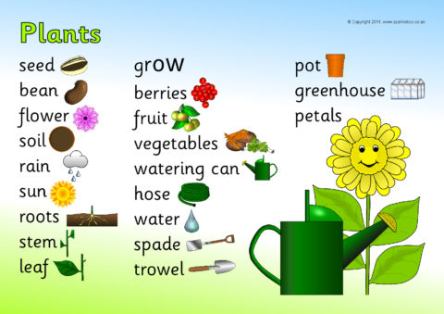
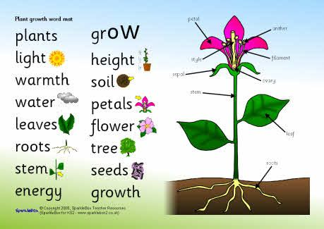
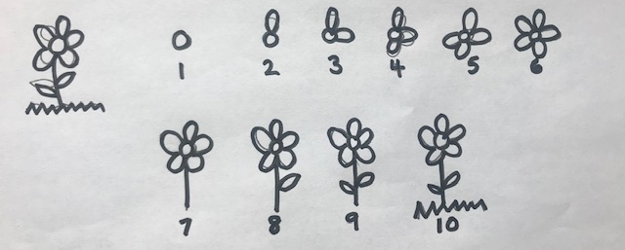
Lesson 5
Use the Plants word bank to play a game of hangman.
Count the letters, ask someone in your family to guess, then swap!
You could have 10 goes but use a flower to countdown ‘lives’
Extra Challenge: put the words into
your own sentences.

Slide 11
Maths Year 2
Home Learning
18th – 22nd May

Slide 12
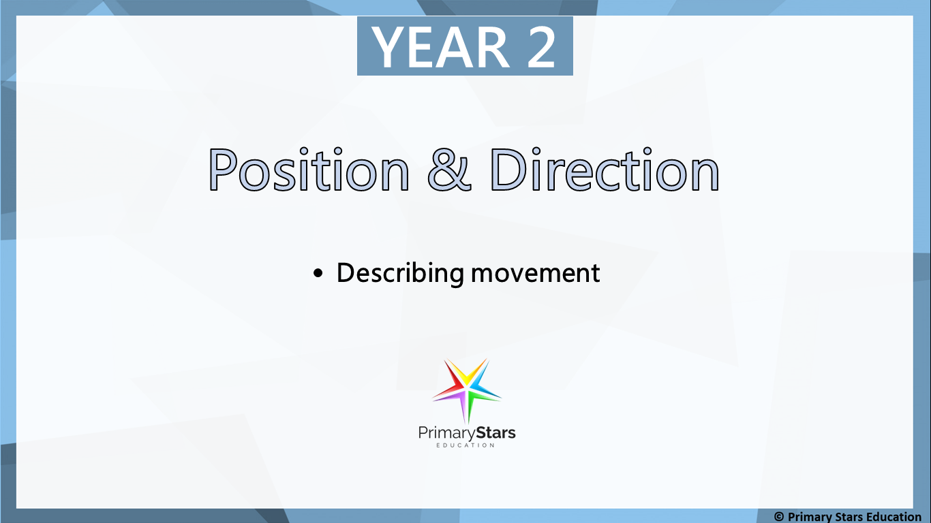
Our focus for Maths this week continues to be Position and Direction .
Please work through the following slides, there is a lesson for each day of the week.
Key vocabulary:
position, direction, forwards, backwards, left, right, up, down, over, under, underneath, above, below, top, bottom, side, on, in, outside, inside, around, in front, behind, front, back, beside, next to, opposite, apart, between, middle, edge, centre, corner, direction, journey, route, turn, clockwise, anticlockwise.

Slide 13
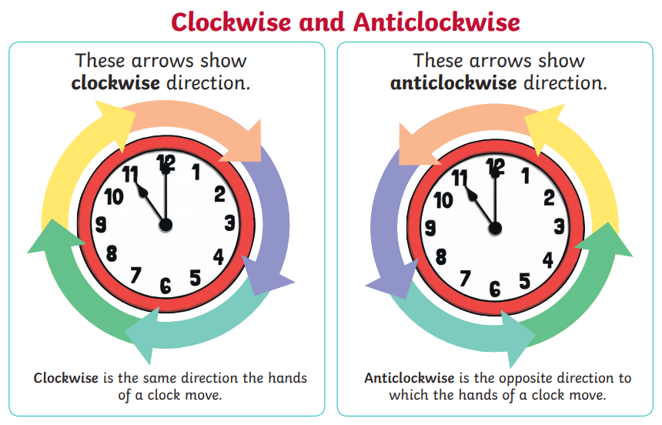
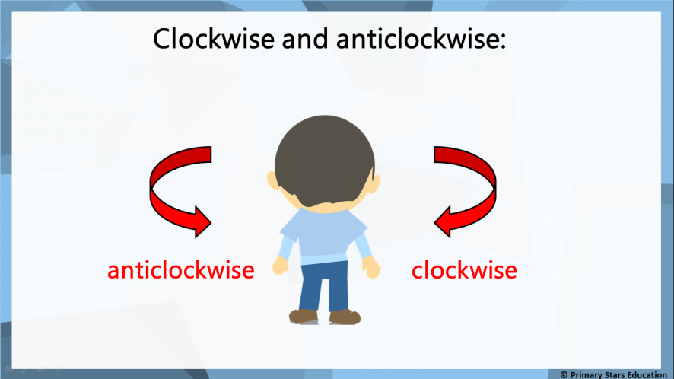
Lesson 1- Clockwise and anti-clockwise
Activity 1
Click on the link to watch a video about clockwise and anti-clockwise.
https://www.bbc.com/bitesize/clips/zjyb9j6
Activity 2 – Practical
- Use a piece of ribbon or anything similar at home and ask an adult to tell you to turn it either clockwise or anti-clockwise (look at the posters for help).
- You could make a paper aeroplane and do the same.
-What other objects turn? Can you find any in your house/garden? Do they only turn in one direction? (toy steering wheels, hula hooping, taps, volume controls etc)

Slide 14
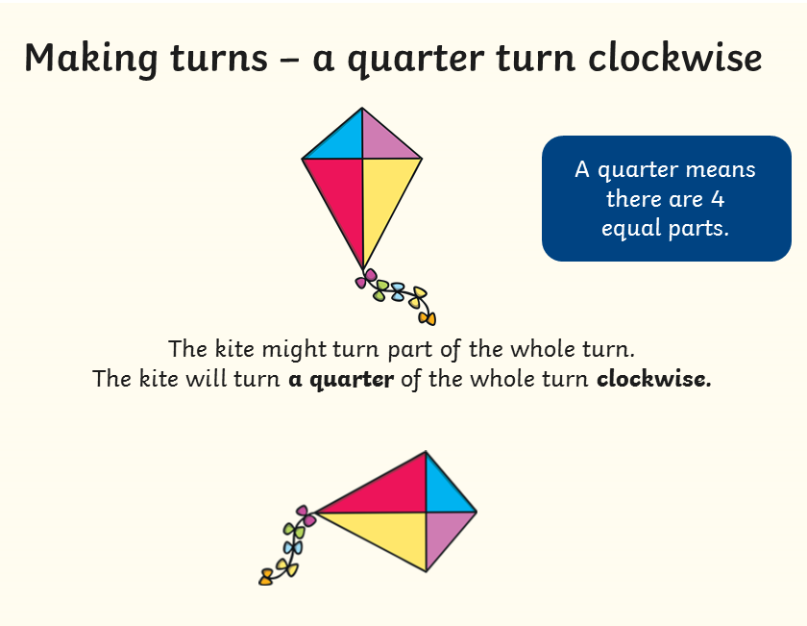
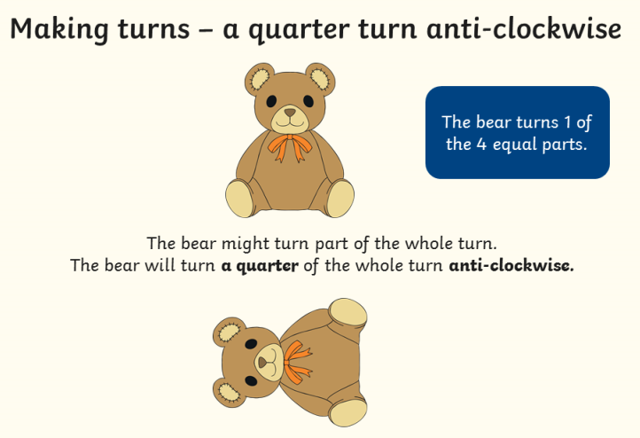
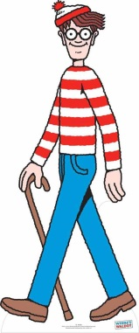

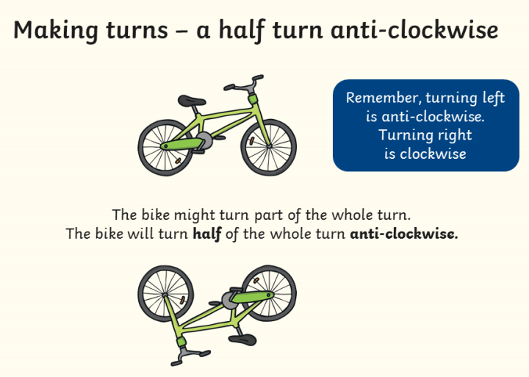
Lesson 2 – Describing turns
Look carefully at how the objects have turned.
Activity 1
Make a little character of your choice and cut it out.
I chose Where’s Wally!
Return your character back to the starting position each time you have made a turn.
Turn your character:
A quarter turn clockwise.
A half turn clockwise.
A quarter turn anti-clockwise.
A half turn anti-clockwise.
*Keep your character, you’ll need it for the next lesson!
Clockwise
Anti-Clockwise

Slide 15
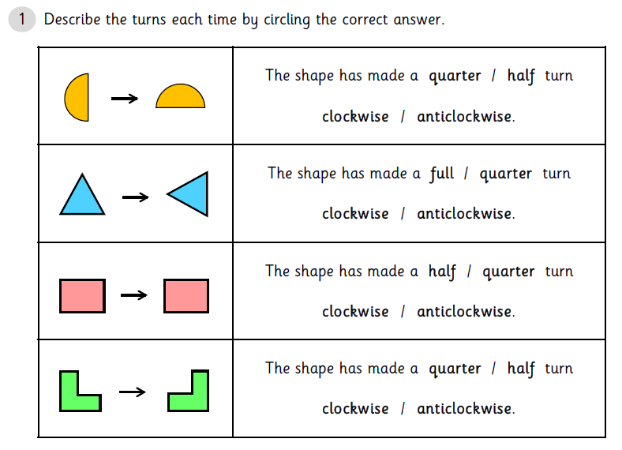
Lesson 2 cont’
Activity 2
Don’t worry if you don’t have a printer, you could draw the shapes and then write a sentence to describe how the shape has turned or talk about it with an adult.

Slide 16
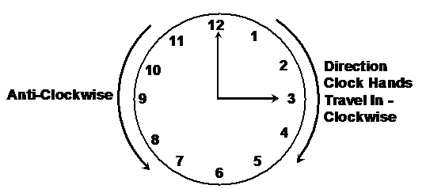
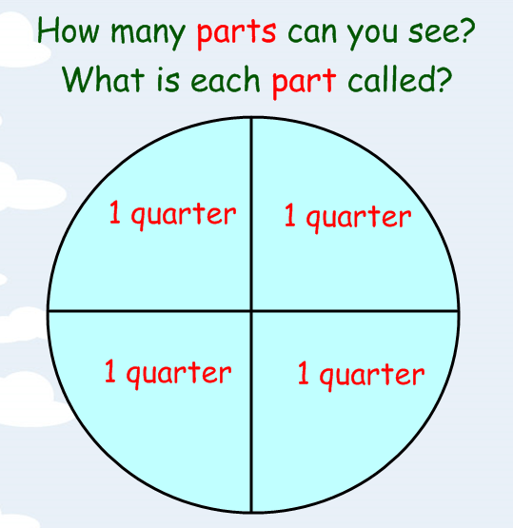
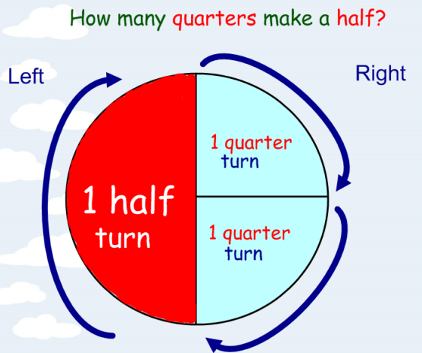
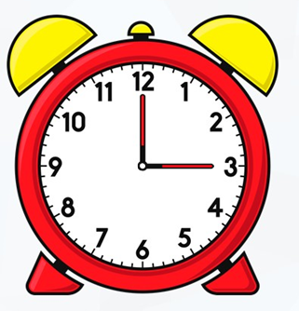
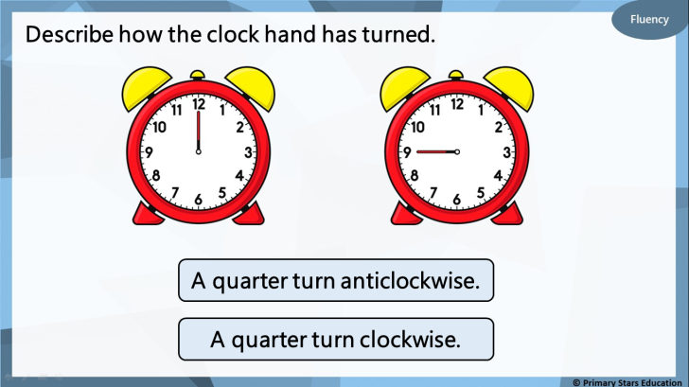

Lesson 3
1. Look at the circles below and think back to our work on fractions.
2. Now look at the clock or a clock in your house and imagine it split into 4 quarters/half.
3. Describe with an adult how the clock hands have moved below.

Slide 17
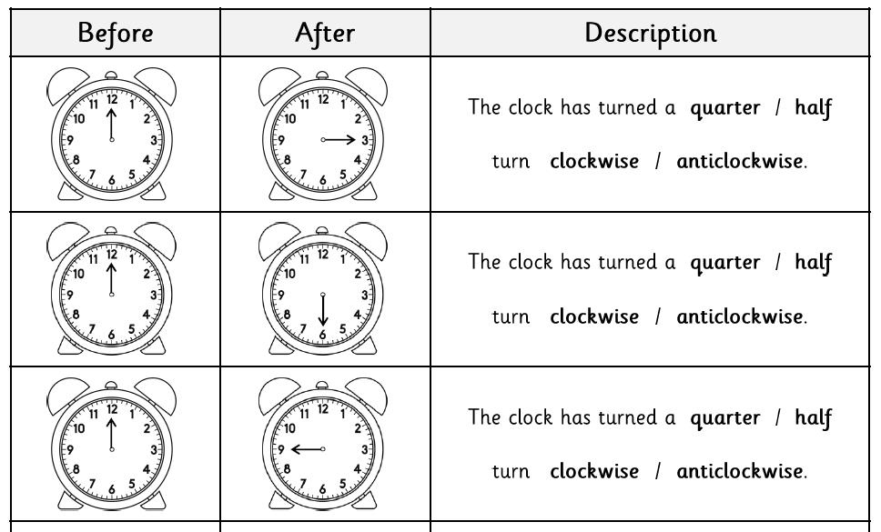
Lesson 3 cont’
Activity
Look at the pictures of the clocks before and after. Write a sentence to describe how the clock hands have moved or tell an adult. The key words are below.

Slide 18
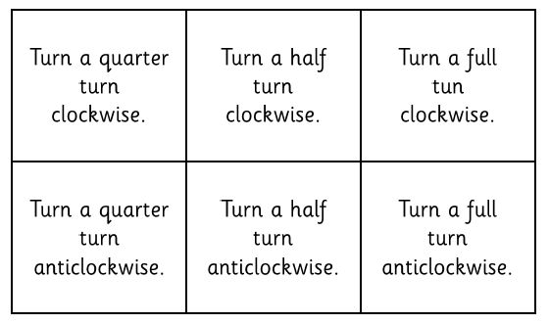

Lesson 4
Activity
Choose an instruction card and move your character to show this.
Draw a table like the one below to show your results.
Start position | Instructions | End position
 | Turn a quarter turn clockwise.

Slide 19
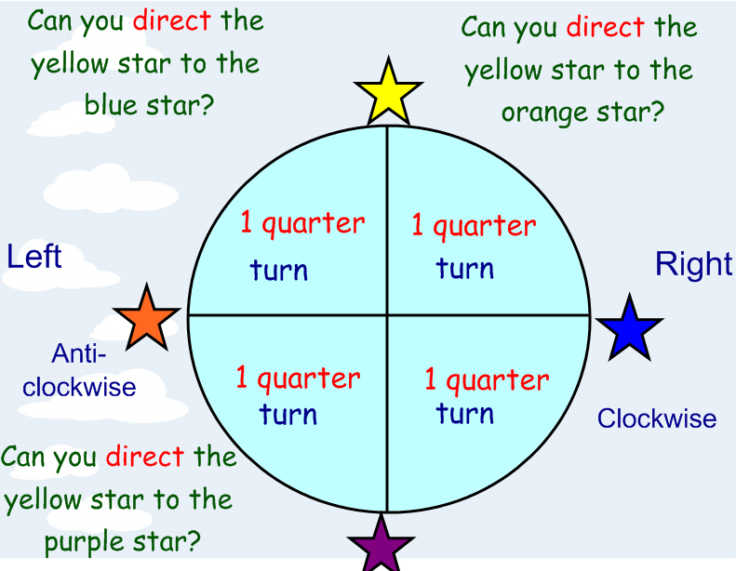
Lesson 5
Being able to describe how to find something someone has lost or how to get somewhere is a really useful skill to have!
Wally needs your help!
Wally is quite forgetful and often loses his (and his friends) things and he needs your help to describe where his things are so he can find them.
Can you think of any words that you could use to direct Wally?
Think back to the work you have done this week.
forward whole turn
backward quarter turn
right half turn
left clockwise
turn anti-clockwise
straight on
Before you help Wally find his things, warm up your brains by answering the questions around the circle.
For example; The yellow star will turn 1 quarter to the right/clockwise to get to the blue star.

Slide 20
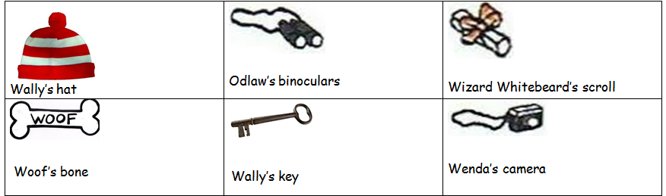

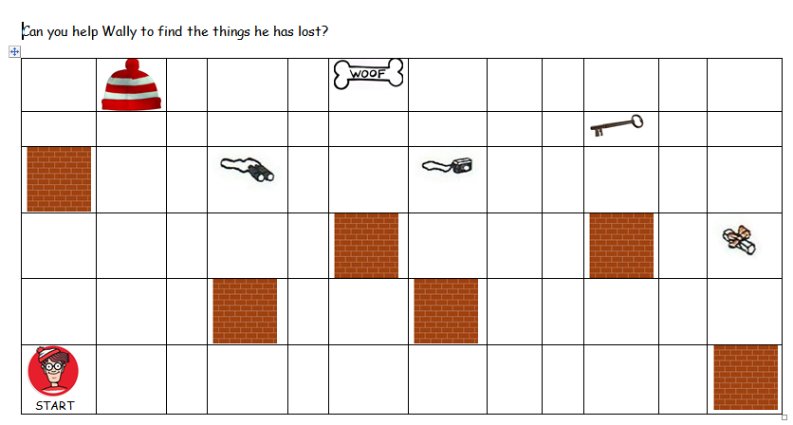
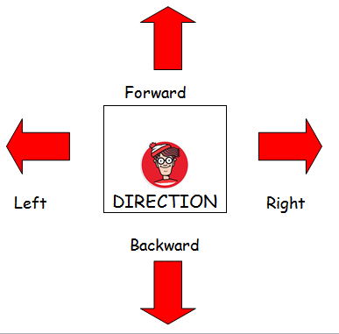
Lesson 5
Choose an object from the card.
Direct Wally from the start to the object you have chosen (you could write the directions down or tell someone in your house, there’s an example in the blue box at the bottom).
*Remember to use vocabulary such as right, left, clockwise, anti-clockwise, quarter turn, half turn, forwards and backwards. CHALLENGE: TRY TO AVOID THE BRICK WALLS.
3. When Wally has reached the object, choose a different one and continue until you’ve chosen all the objects. If you are finding it a little tricky, use forward, backward, left and right instead.
How to get to Wally’s hat.
Turn a quarter turn right.
Move forward one square.
Turn a quarter left.
Move forward 5 squares.
Top tip! Think carefully about where Wally’s hat is pointing when turning.

Slide 21
Topic Year 2
Year 2 – Science
And the Broader Curriculum
Plants
Home Learning

Slide 22


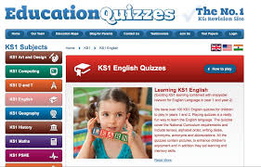
Science - Plants
Watch these time lapse videos:
Seed germination:
https://www.youtube.com/watch?v=oDBX2gCXxYw
A sunflower growing:
https://www.youtube.com/watch?v=Z-iPp6yn0hw
Now try to complete the answers in this online quiz.
Use all your knowledge about Plants to answer the questions.
https://www.educationquizzes.com/ks1/science/plants-what-makes-them-grow/

Slide 23
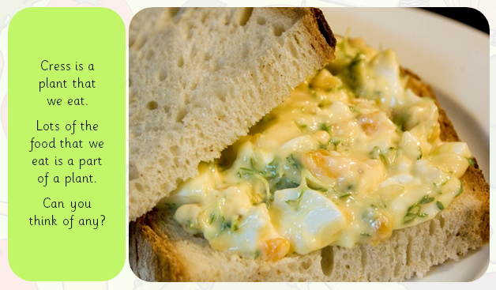
Plants as Food
What do we Eat?
Hint: The next few slides are full of ideas for you to think and talk about.

Slide 24
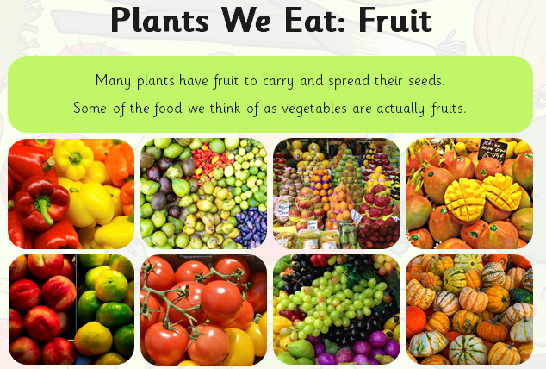
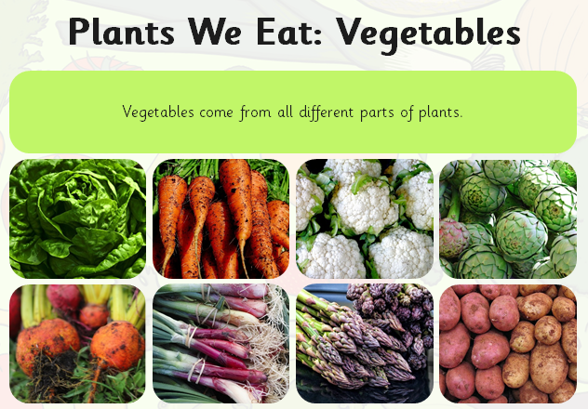
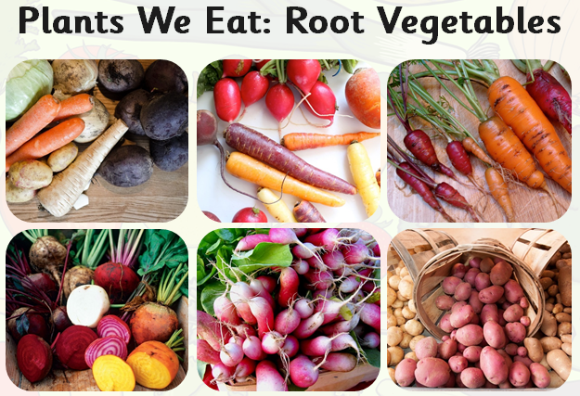
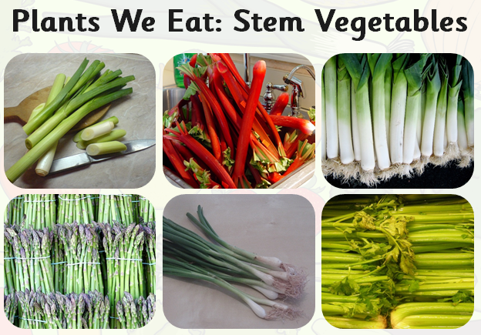

Slide 25
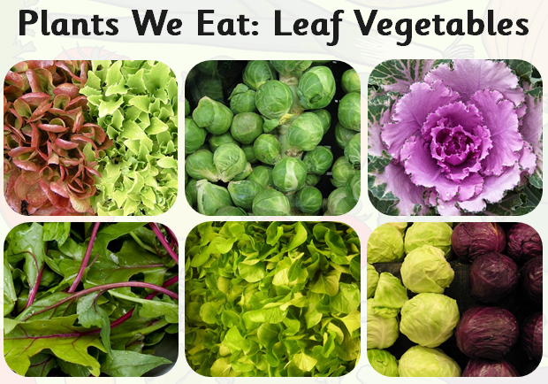
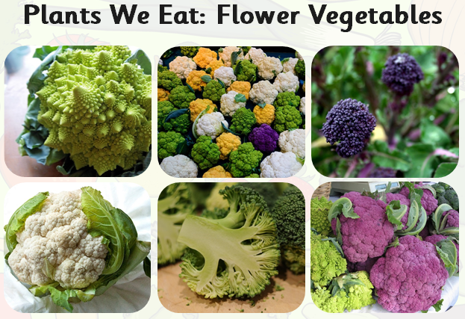
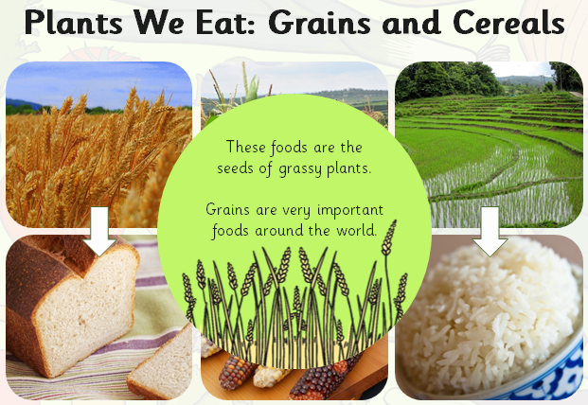
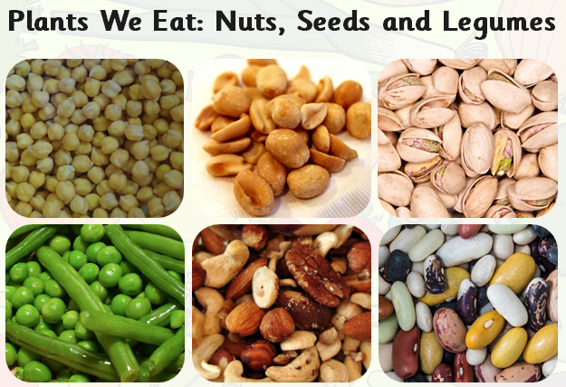

Slide 26
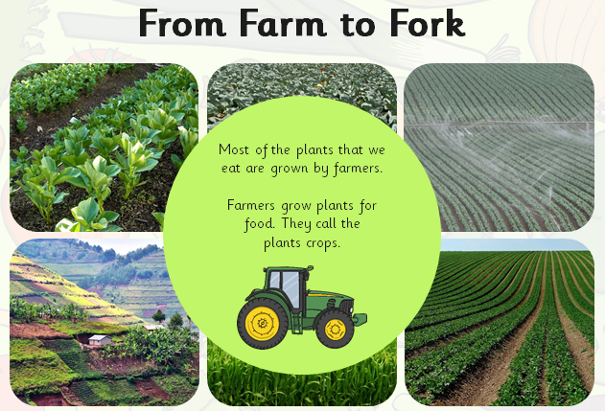
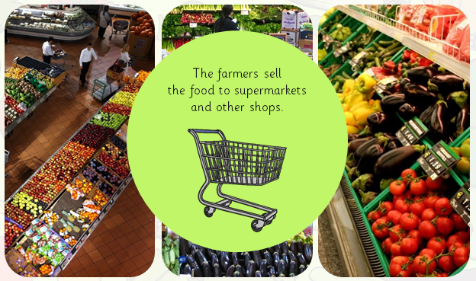
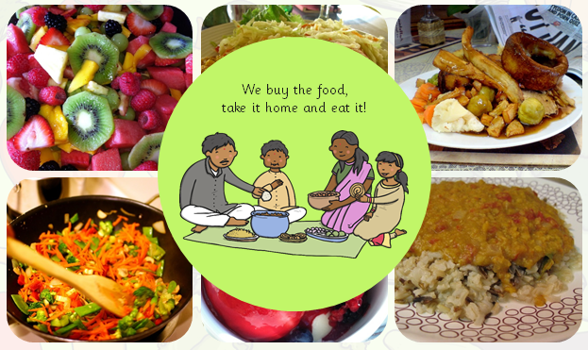

Slide 27
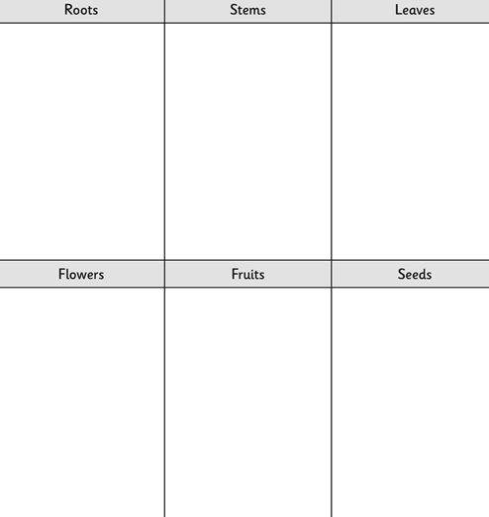
Plants as Food
What do we Eat?
Task:
Think about the plants you have eaten before.
Can you make some lists of the different types of plants that we eat as food.
You could draw some diagrams and add labels.
The ideas on the next slide might help you.

Slide 28
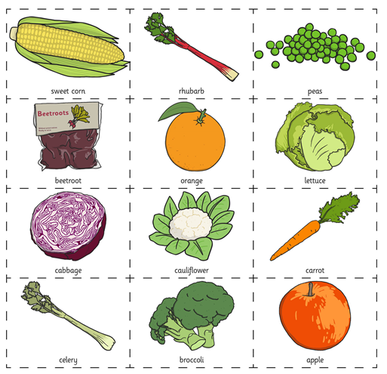
Plants as Food
What do we Eat?
Roots
Stem
Leaves
Flowers fruit
Seeds
How would you group these?
Could you use the headings above?

Slide 29

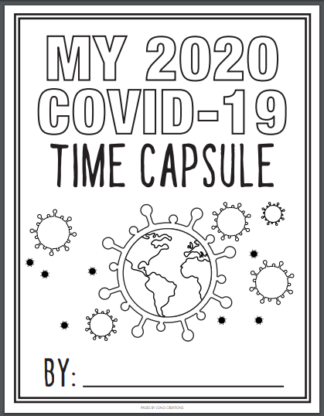
East Riding Schools Library Service have launched an activity pack …
They say:
How to take part:
At this stage, we are really wanting to encourage as many children as possible to record their thoughts, feelings and experiences. This will give them the ability to reflect on those feelings when we launch the competition, later in the year. For now, it is quite simple …
Time Capsule Pack
They will be launching a competition soon, but in the meantime say this Covid-19 Time Capsule would give children the opportunity to record their thoughts and feelings, which they can draw on to produce entries for their competition.
Find the Time Capsule activities here:
https://s3.letsembark.ca/long-creations/2020-COVID-19-Time-Capsule-EN-US.pdf

Slide 30
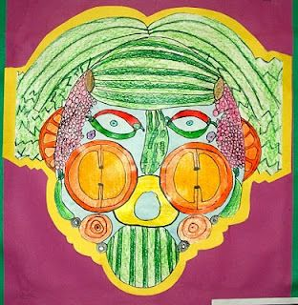
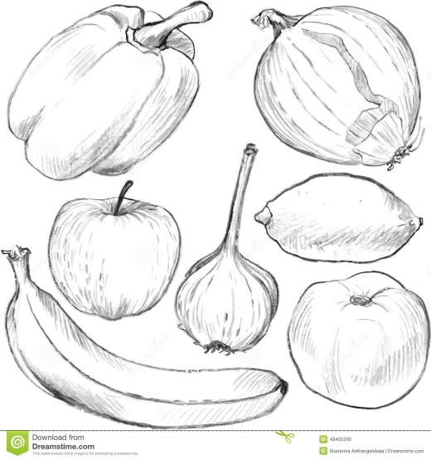
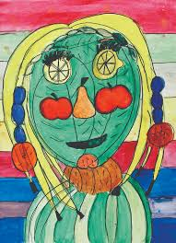
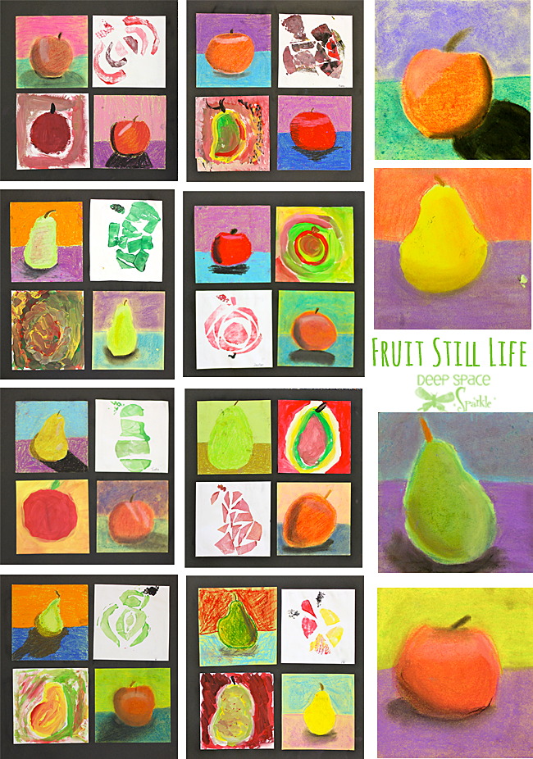
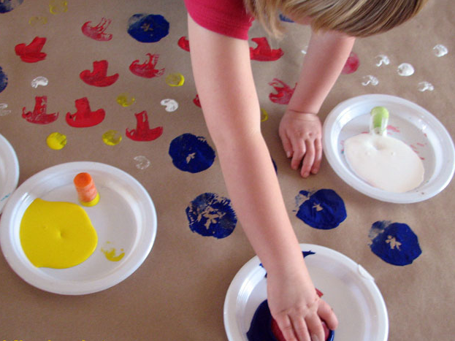
Art
Can you use Plants We Eat to inspire some artwork of your own?

Slide 31

ICT You can continue with your PowerPoints
Use a laptop or computer (if you have access to one) to create your own PowerPoint about Plants.
Remember you can minimise the PowerPoint program and search Google for an image to copy and paste into your PowerPoint.
Use Right Click, Copy Image and Paste just like we have in the ICT suite. Add some text to make it interesting. A Heading and a sentence is ideal.
You can add a few new slides to your PowerPoint each week.
Could you create a PowerPoint about one of these:
-Georgia O’Keeffe?
-Your family?
-What you are good at?
-favourite things?

Slide 32
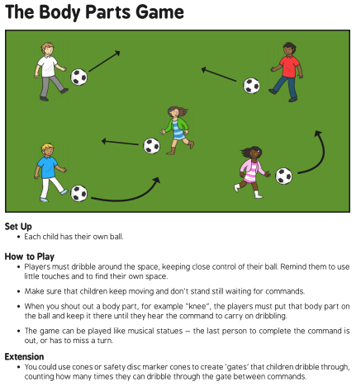
PE
For PE, continue to work on your ball skills.
At Home Adaptions:
You could adapt this game for the amount of space you have. You could play with one or more people and adapt the game for the number of players from your family.

Slide 33

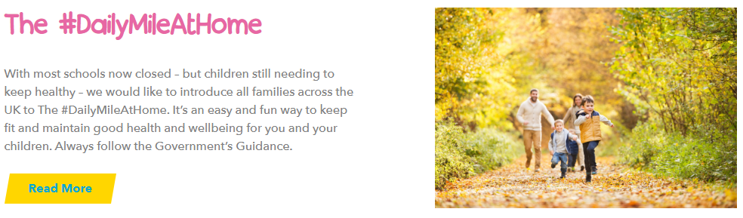
PE
Keep being active, it is good for your heart, health and mind!
You can continue with The Daily Mile
If we were at school together we would be walking and running ‘The Daily Mile’ around our school field each day.
Have a look here for more information:
https://thedailymile.co.uk/
Try to run or walk each day – It makes you feel great!

Slide 34

PE
Keep being active:
Go Noodle
https://www.gonoodle.com/
BBC Supermovers
https://www.bbc.co.uk/teach/supermovers/ks1-collection/zbr4scw
Music with Mike
https://www.youtube.com/channel/UCC_0fin1Ya8ZuqU2RxARlZw
Just Dance
https://www.youtube.com/channel/UChIjW4BWKLqpojTrS_tX0mg
NHS Active Kids
https://www.nhs.uk/change4life/activities/sports-and-activities

Slide 35
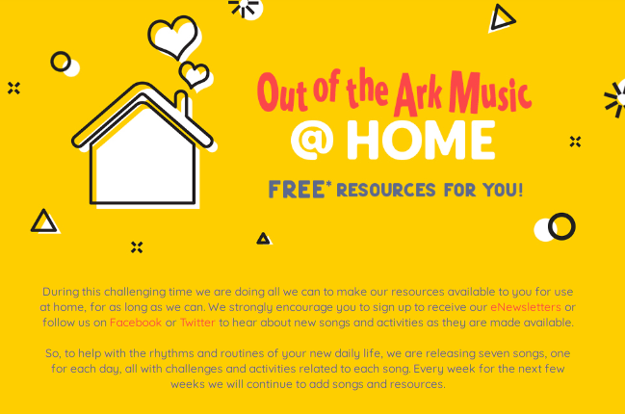

Music
Free Music resources are available at:
https://www.outoftheark.co.uk/ootam-at-home/
This is a fantastic free resource with daily activities for each new week.

Slide 36








RE
This half term we are thinking about ‘What are the Big questions?’
Last week we thought about the Christian story of Creation. Can you remember what happened on each day? Look at the pictures for clues.
Here is this week’s activity.
Read this Creation poem by Steve Turner from the book ‘In the Beginning’.
God said WORLD and the world spun round
God said LIGHT and the light beamed down
God said NIGHT and the sky went black
God said LAND and the sea rolled back
God said LEAF and the shoot pushed through
God said FIN and the first fish grew Activity – On the next page is a copy of
God said BEAK and the bright birds soared the poem that has been left for you to
God said FUR and the jungle ROARED complete using your own ideas.
God said SKIN and the man breathed air You can choose to do a few lines or the
God said BONE and the girl stood there whole poem. Remember poems do not
God said GOOD and the world was great always have to rhyme!
God said REST and they all slept late.

Slide 37
RE Poem- ‘In the Beginning’
God said WORLD and _____________________________________
God said LIGHT and _____________________________________
God said NIGHT and _____________________________________
God said LAND and ______________________________________
God said LEAF and _______________________________________
God said FIN and _______________________________________
God said BEAK and ______________________________________
God said FUR and _______________________________________
God said SKIN and ______________________________________
God said BONE and ______________________________________
God said GOOD and ______________________________________
God said REST and ______________________________________

Slide 38

Wellbeing Resources
Yoga for Kids!
https://www.youtube.com/watch?v=X655B4ISakg
Cosmic Kids Yoga:
https://www.youtube.com/user/CosmicKidsYoga
Puppy Mind Story:
https://www.youtube.com/watch?v=Xd7Cr265zgc
Stop Breathe Think Kids
https://www.stopbreathethink.com/kids/
BBC schools well-being video clips:
https://www.bbc.co.uk/bitesize/topics/zxccwmn/resources/1
ELSA coronavirus story for children:
https://www.elsa-support.co.uk/wp-content/uploads/2020/03/Childrens-story-about-coronavirus.pdf
For more information for Parents:
https://www.place2be.org.uk/about-us/news-and-blogs/2020/march/coronavirus-supporting-children-who-may-be-especially-vulnerable/

